Slide 1
Speed and Velocity in One and Two Dimensions
Linear Motion in One Dimension
Linear Motion in Two Dimensions
Speed and Other Scalar Quantities
Velocity and Other Vector Quantities
Position and Displacement
Position and Velocity Graphs
Tangents and Instantaneous velocities
Displacement and Velocity in Two Dimensions
Vector Addition, Cosine Law and Sine Law

Slide 2
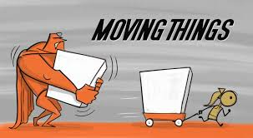
Kinematics
The study of motion

Slide 3
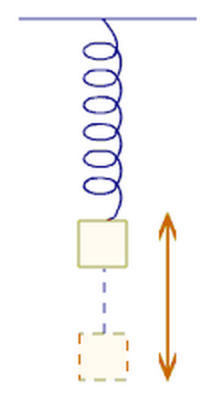
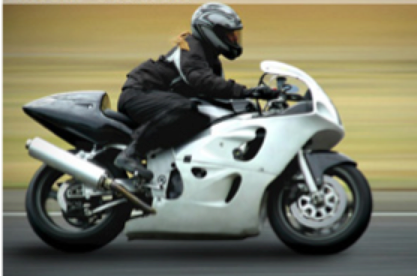
Linear Motion in One Dimension
Motion along a straight line (left/right or up/down)
E.g.
Motion of a train along a straight line
An object, like a ball, falling freely, vertically under gravity
The vertical up and down oscillations of an object suspended from a vertical spring.

Slide 4
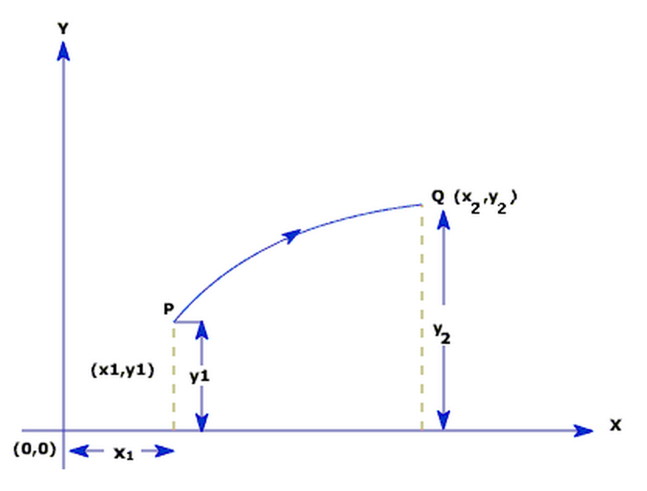
Linear Motion in Two Dimensions
Movement along two different axes (x and y)
A particle moving along a curved path in a plane has two dimensional motion. The figure below, illustrates a particle moving from P (x1, y1) to Q (x2, y2) along a curved path.
i.e. A dog running on level
ground 24 m eastward and
then 11 m southward
undergoes motion in two
dimensions.

Slide 5
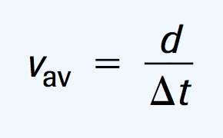
Speed and Other Scalar Quantities
Scalar quantities, which have magnitude (or size) but no direction.
i.e. Speed, Distance and Time
Instantaneous speed - speed at a particular instant
Average speed – total distance travelled divided by total time of travel

Slide 6
Check Your Understanding Ensure SI Units
What is the average speed of a cheetah that sprints 100 meters in 4 seconds?
If a car has an average speed of 60 km/h, how far will it travel in 10 hours?
If your odometer reading increases by 40 km over a 30 minute time period, what was your average speed?

Slide 7
Check Your Understanding Solutions
V_{av} = d/Δt = 100 m/4 s = 25 m/s
d = 60 km/h X 10 h = 600 km
V_{av} = d/Δt = 40 km / 0.5 h = 80 km/h

Slide 8
Velocity and Other Vector Quantities
A vector quantity is a quantity with a magnitude and direction.
I.e. Displacement, and velocity
I.e. 20 km/h [E]

Slide 9
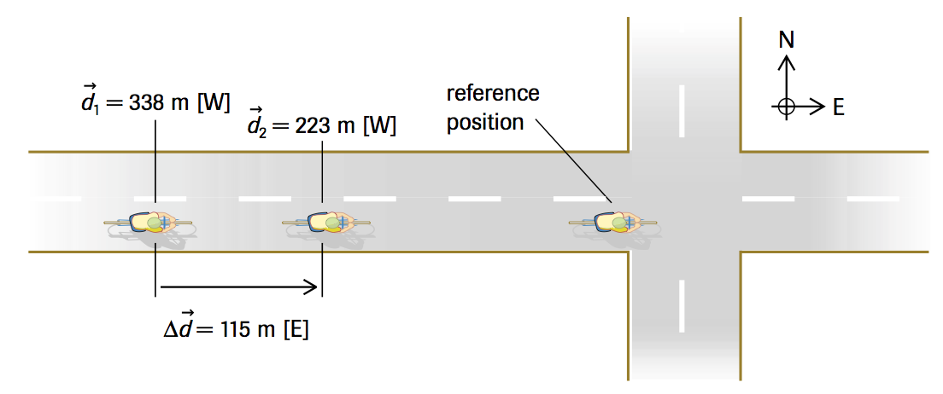
Position and Displacement
Position, is the directed distance of an object from a reference point
Displacement is how far an object is from its starting point
Final position – starting position

Slide 10
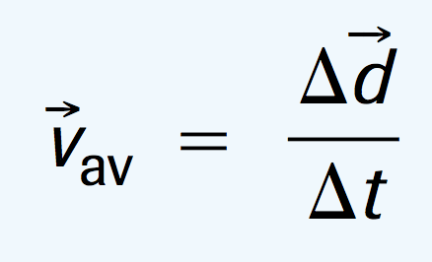
Velocity
The rate of change of position
Instantaneous velocity - velocity at a particular instant
Change of position divided by the time interval for that change

Slide 11
Check Your Understanding
A cyclist takes 25.1 s to cover the displacement of 115 m [E] from d₁ to d₂.
(a) Calculate the cyclist’s average velocity.
(b) If the cyclist maintains the same average velocity for 1.00 h, what is the total displacement?
(c) If the cyclist turns around at d₂ and travels 565 m [W] to position d₃ in 72.5 s, what is the average velocity for the entire motion?

Slide 12
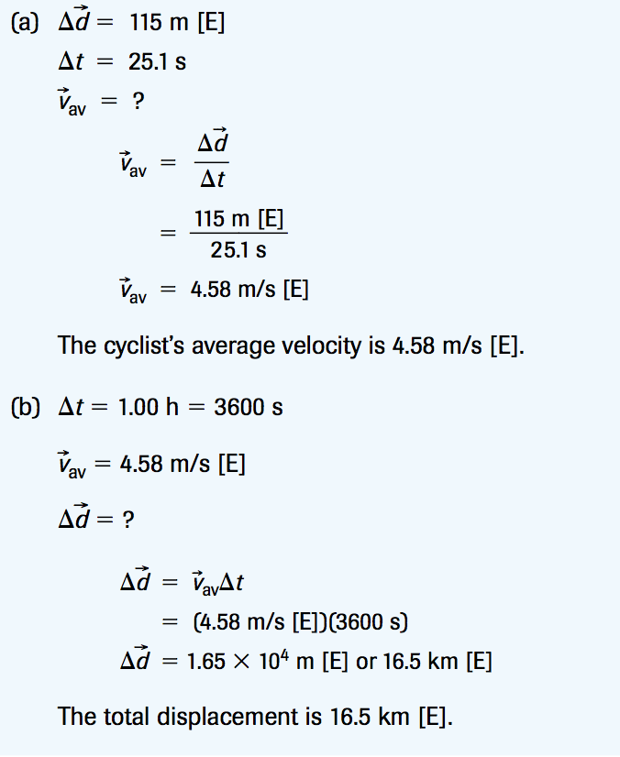
Check your Understanding
Displacement = 565 m – 115 m = 450 m [W]
Time = 25.1 s + 72.5 s = 97.6 s
Average velocity = displacement / time
= 450 m [W] / 97.6 s = 4.61 m/s [W]

Slide 13
Think About It
Is it possible for the total distance travelled to equal the magnitude of the displacement? If “no,” why not? If “yes,” give an example.
Is it possible for the total distance travelled to exceed the magnitude of the displacement? If “no,” why not? If “yes,” give an example.
Is it possible for the magnitude of the displacement to exceed the total distance travelled? If “no,” why not? If “yes,” give an example.
Can the average speed ever equal the magnitude of the average velocity? If “no,” why not? If “yes,” give an example.
A truck driver, reacting quickly to an emergency, applies the brakes. During the driver’s 0.32 s reaction time, the truck maintains a constant velocity of 27 m/s [fwd]. What is the displacement of the truck during the time the driver takes to react?
answer to #5 8.6 m [fwd]

Slide 14
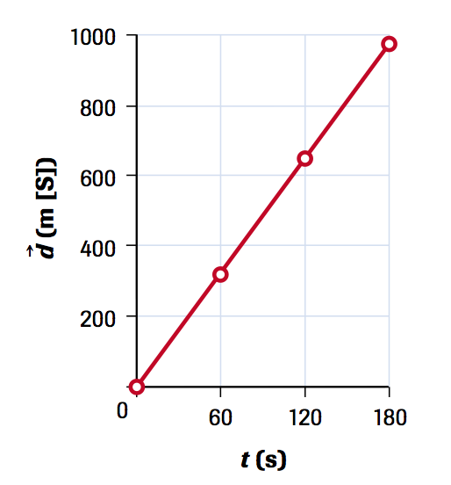
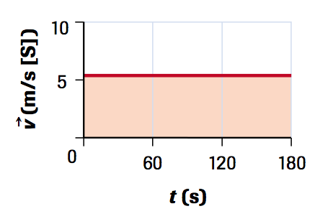
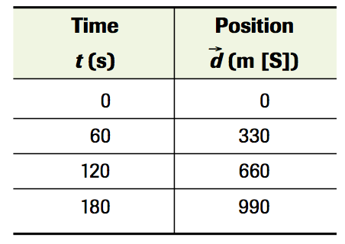
Position and Velocity Graphs – Uniform Motion
For a constant velocity motion (the same velocity is maintained), the position-time graph is a straight line and the velocity-time graph is horizontal.
Position-Time Data Position-Time & Velocity-Time Graphs

Slide 15
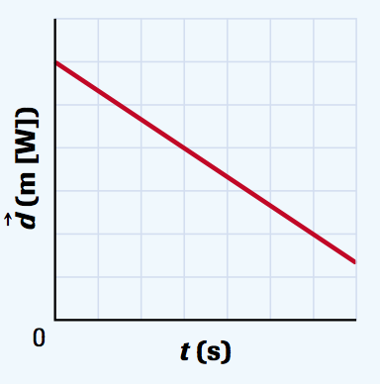
Check Your Understanding
Describe the motion for the graph on the right and sketch the corresponding velocity-time graph

Slide 16
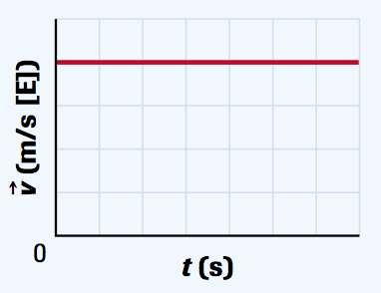
Check Your Understanding Solution
The slope of the line is constant and it is negative. This means that the velocity is constant in the easterly direction. The initial position is away from the origin and the object is moving toward the origin.

Slide 17
Position and Velocity Graphs – Non-uniform Motion
Motion that involves a change in direction, speed or both – i.e. a car speeds up
To find the slope of a curved line at a particular instant, we draw a straight line touching the curve at that point. This straight line is called a tangent to the curve. The slope of the tangent is the instantaneous velocity.
Average velocity can be found by dividing the change in position (Δd) by the change in time (Δt) for a particular period

Slide 18
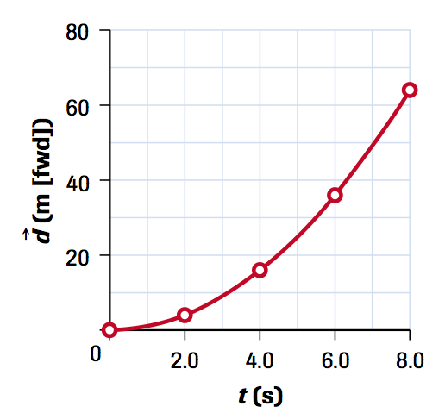
Tangents and Instantaneous velocities
Draw the tangent at times 2 and 6 seconds. Determine the instantaneous velocities at those points

Slide 19
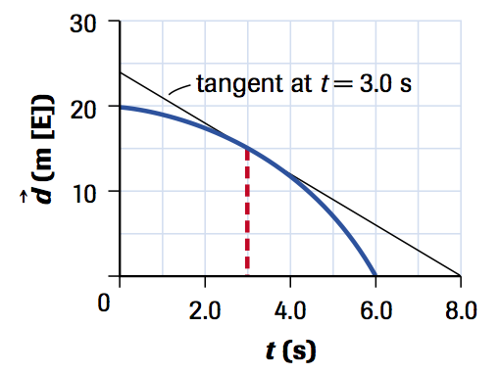
Check Your Understanding
This is the position-time graph for a golf ball rolling along a straight trough which slopes downward from east to west.
(a) Describe the motion. (b) Calculate the instantaneous velocity at t = 3.0s. (c) Determine the average velocity between 3.0 s and 6.0 s.

Slide 20
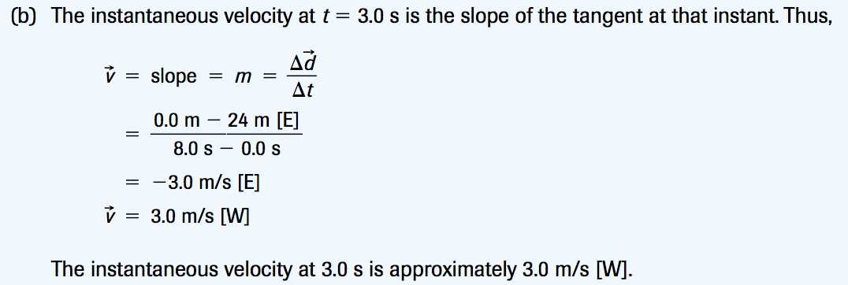
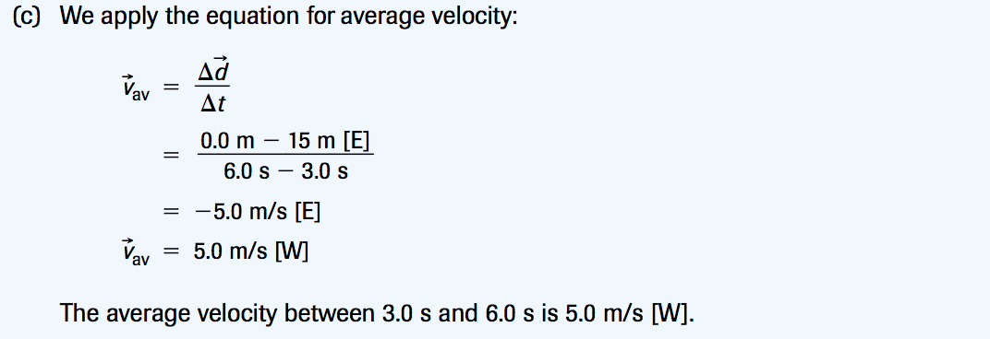
Check Your Understanding - Solutions

